Slide 1

Intro to Artificial Intelligence : Project Proposal
Professor: Dr. Vahid Behzadan
Presented by Team 14
Yuva Krishna Kishore Inapala
Rahul Gaddam

Slide 2
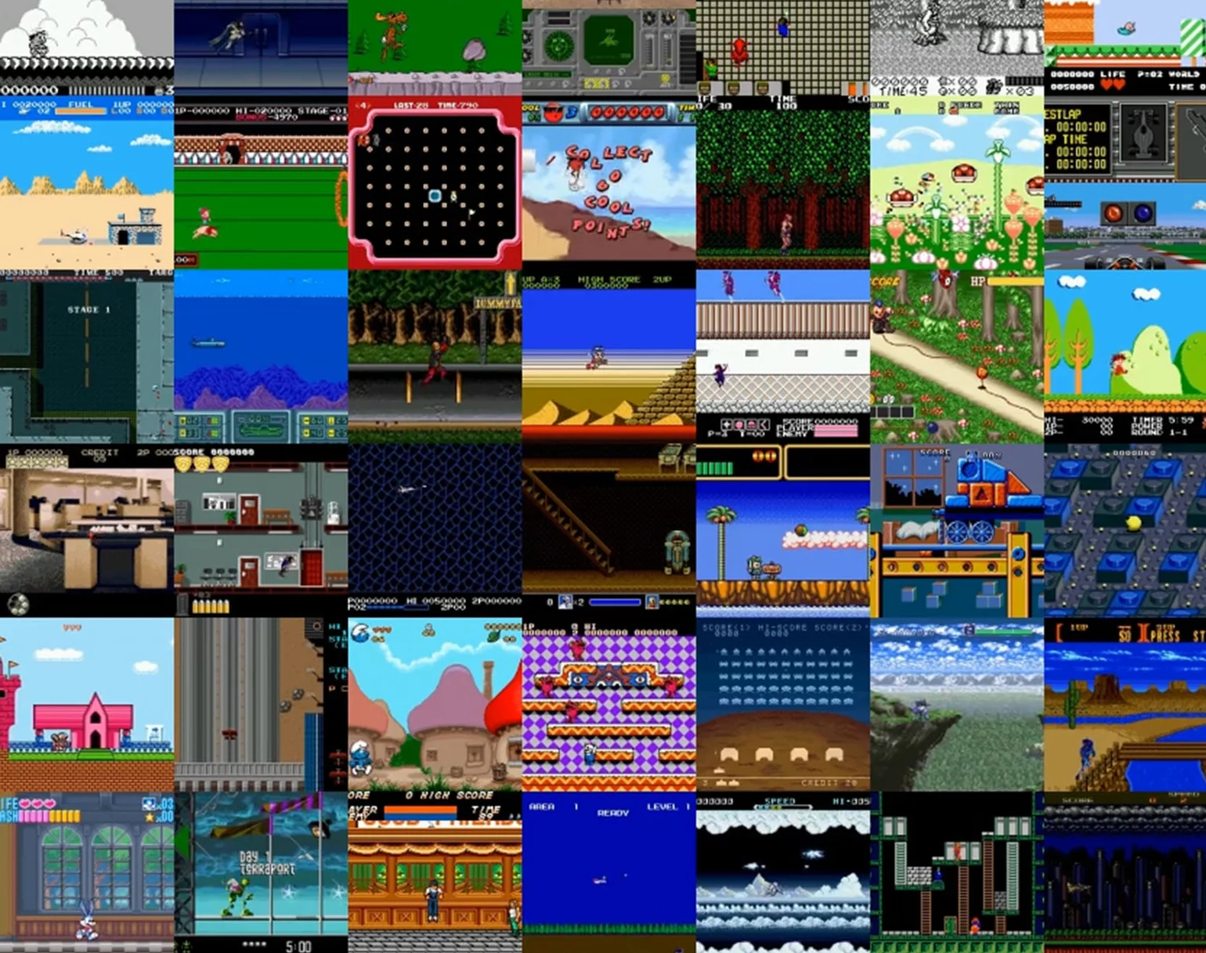
Reinforcement Learning for Game Playing

Slide 3
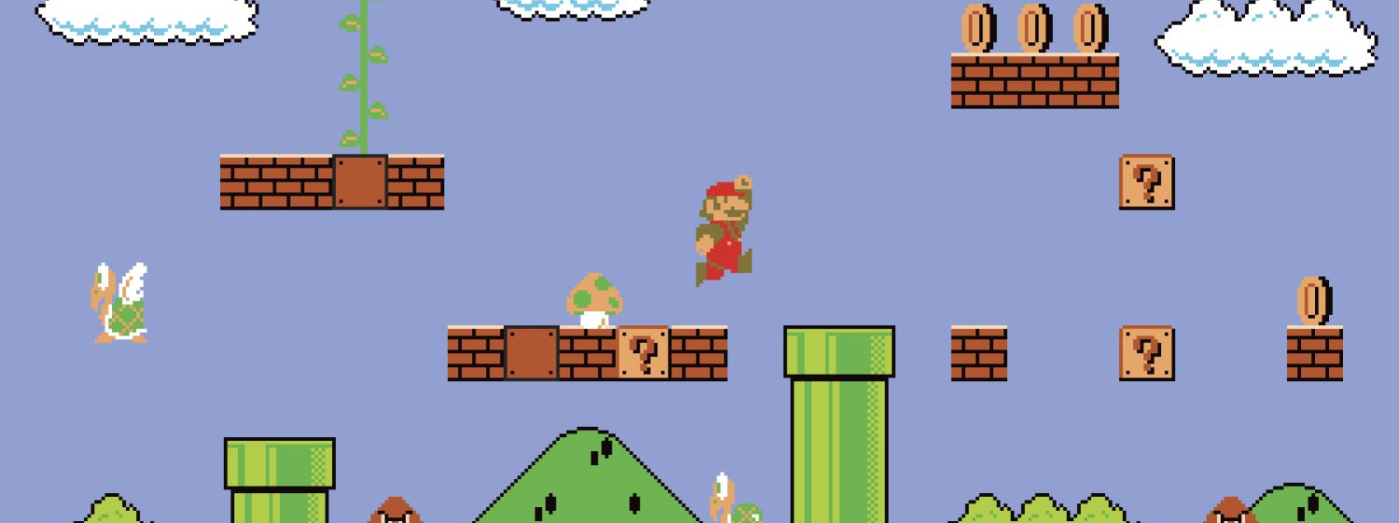
Objective:
The objective of this project is to train a smart agent through reinforcement learning. We are applying Proximal Policy Optimization model for training.

Slide 4
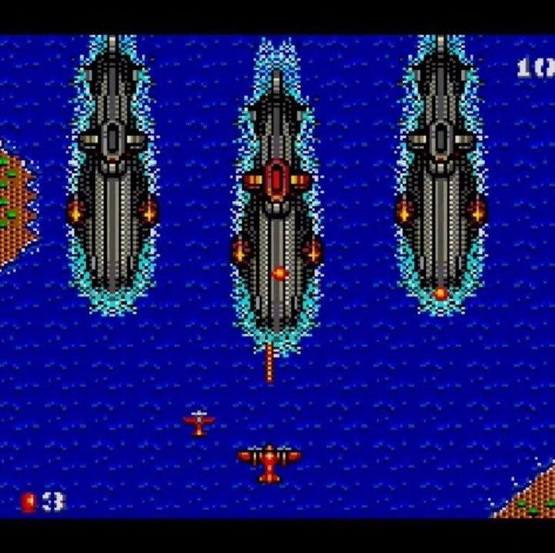
Approach:
Frameworks/libraries: gym, stable-retro, these python libraries help us to run and play the game. OpenCV helps in analyzing and faster training.
Techniques: Studying random actions and resultant rewards from at every step and trains agent.
Algorithm: Proximal Policy Optimization(PPO)

Slide 5
Deliverables:
Source code
Documentation
Presentation
Game

Slide 6
Methodology:
Using stable-retro(gym-retro) we are going to emulate the game(TMNT-TF) and we input random action to the agent, and we are going to use open-cv to analyze the screen time actions and it’s impact by comparing each frame.
We are going to run this on multiple trail runs and using one of the best trail run to train the model.
After training smart agent will play by predicted the game actions.

Slide 7
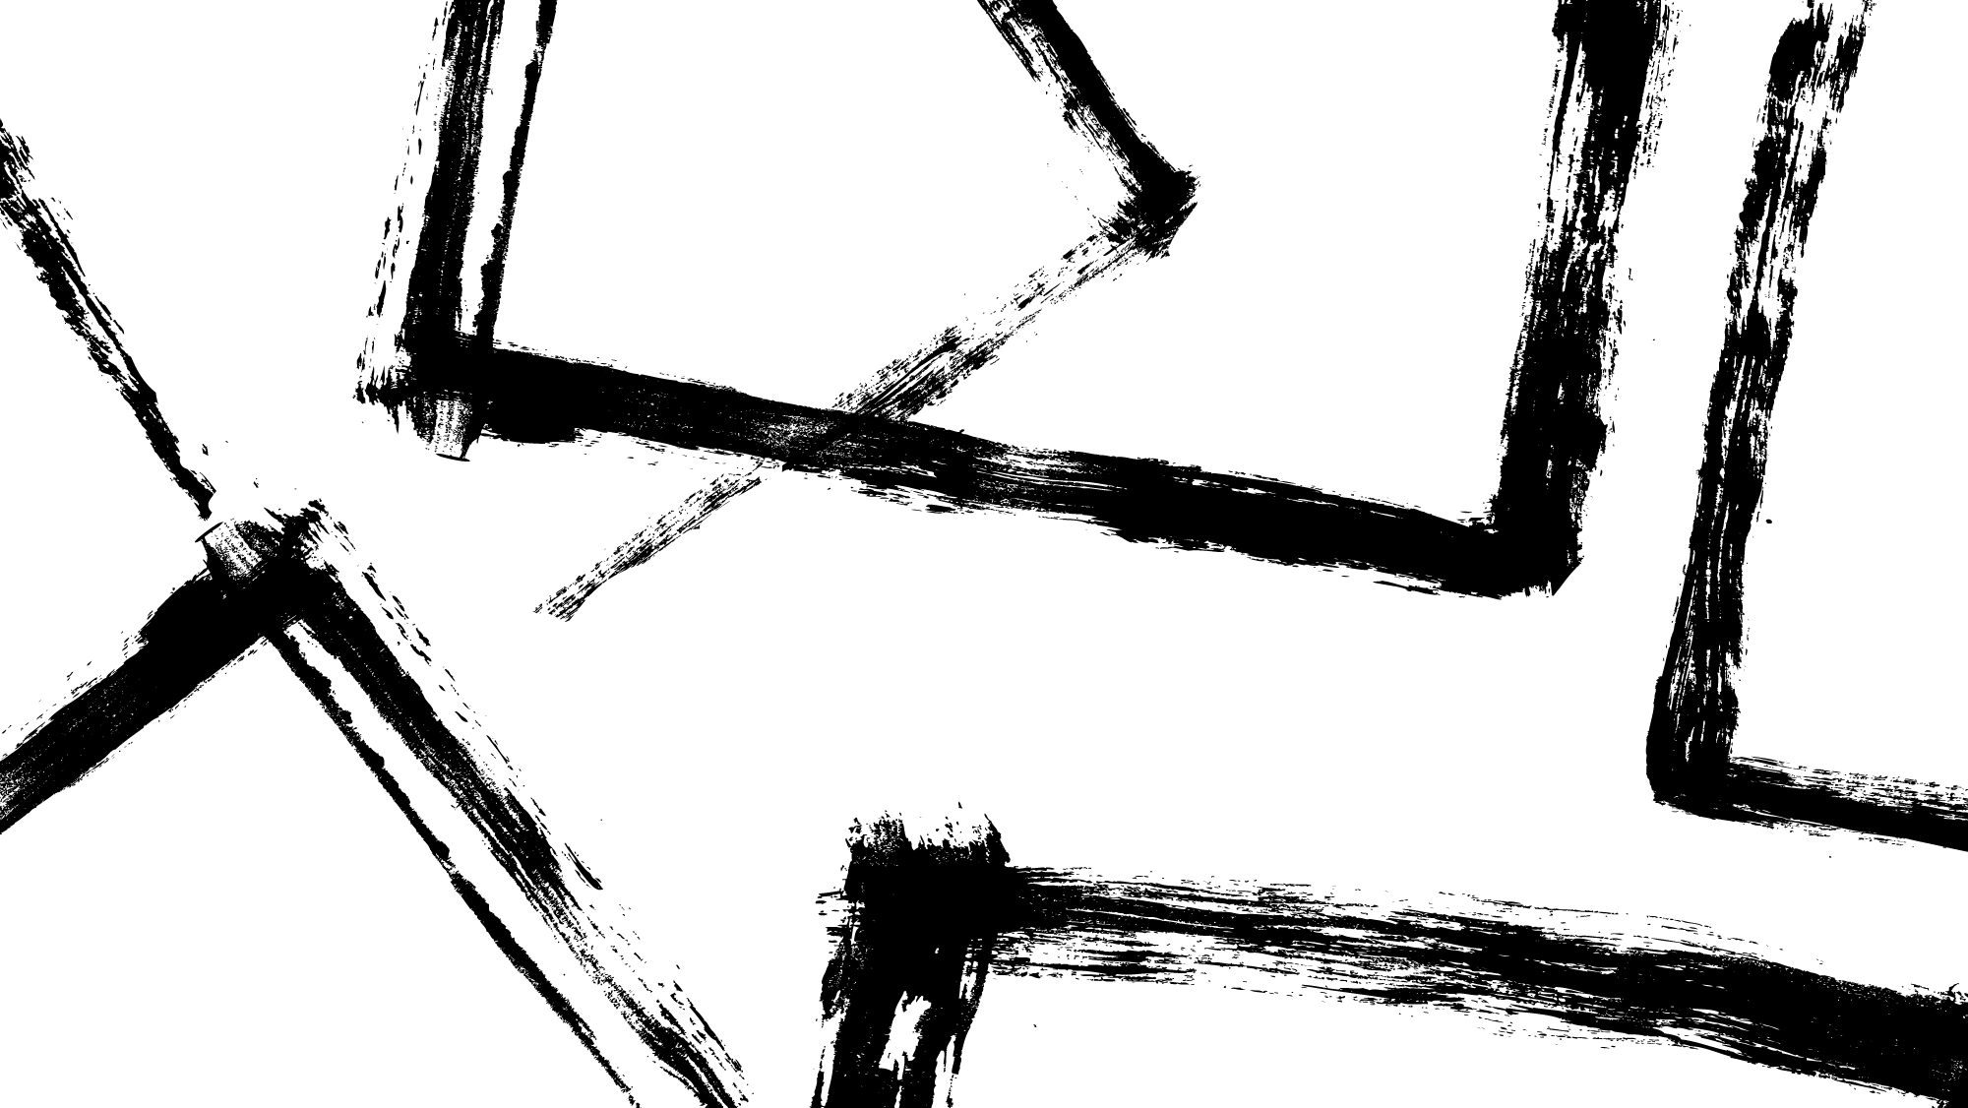
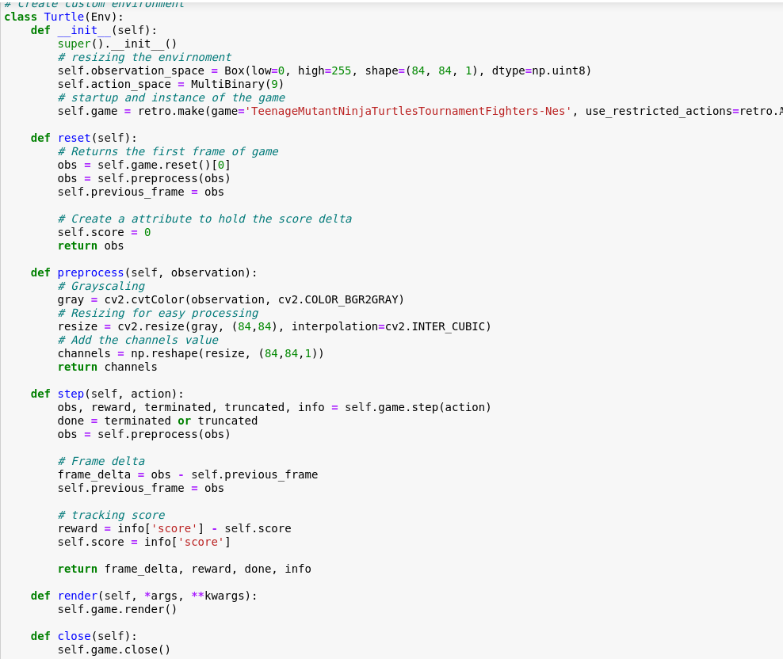
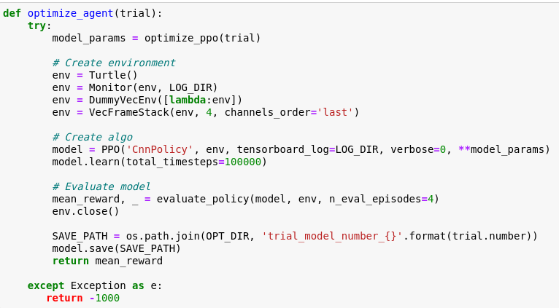
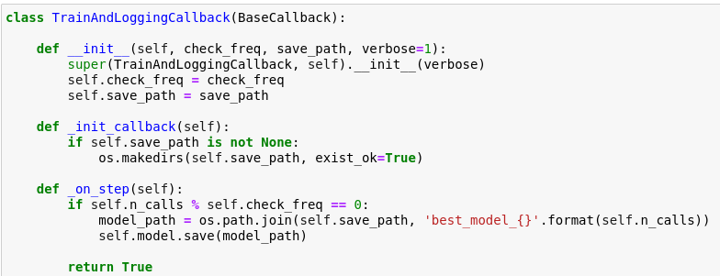
Source code
Game Function:
Trail Model generation Function:
Callback Function:

Slide 8
Evaluation Methodology:
Review
01
Review the source code
Analyze
03
Analyze the Agent's performance by reviewing its decision-making processes in various game scenarios.
Test
02
Test the agent to ensure that it follows the established game rules, character movement, actions, and win conditions without errors.

Slide 9

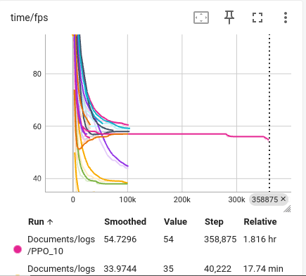
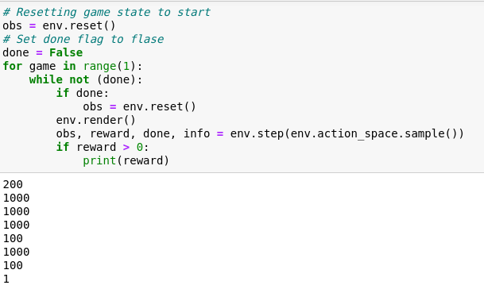
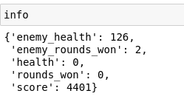
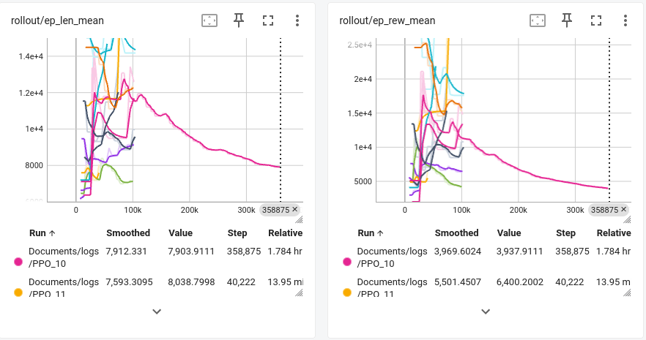
Test and Analysis:
We can test and analyze the agent performance through tensorboard and following codes.

Slide 10
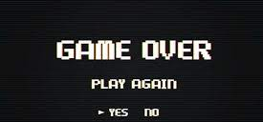
Thank You

